Slide 1
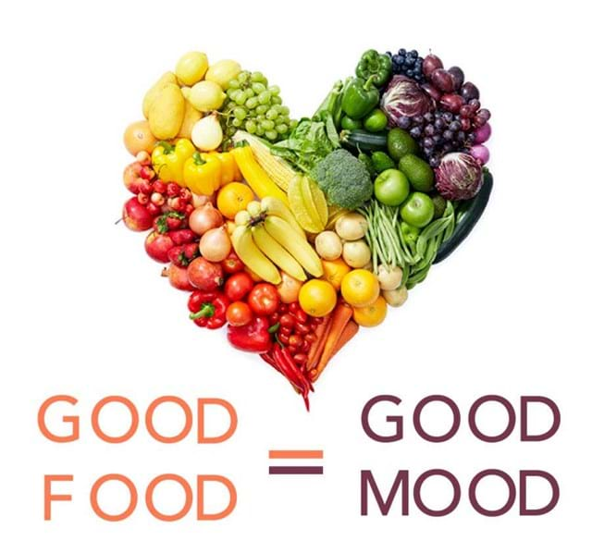

All of us know,
Good Food
=
Good Mood
However , we often neglect this
crucial aspect of health due to our
busy lifestyles, which impacts
our physical and mental well-being.

Slide 2
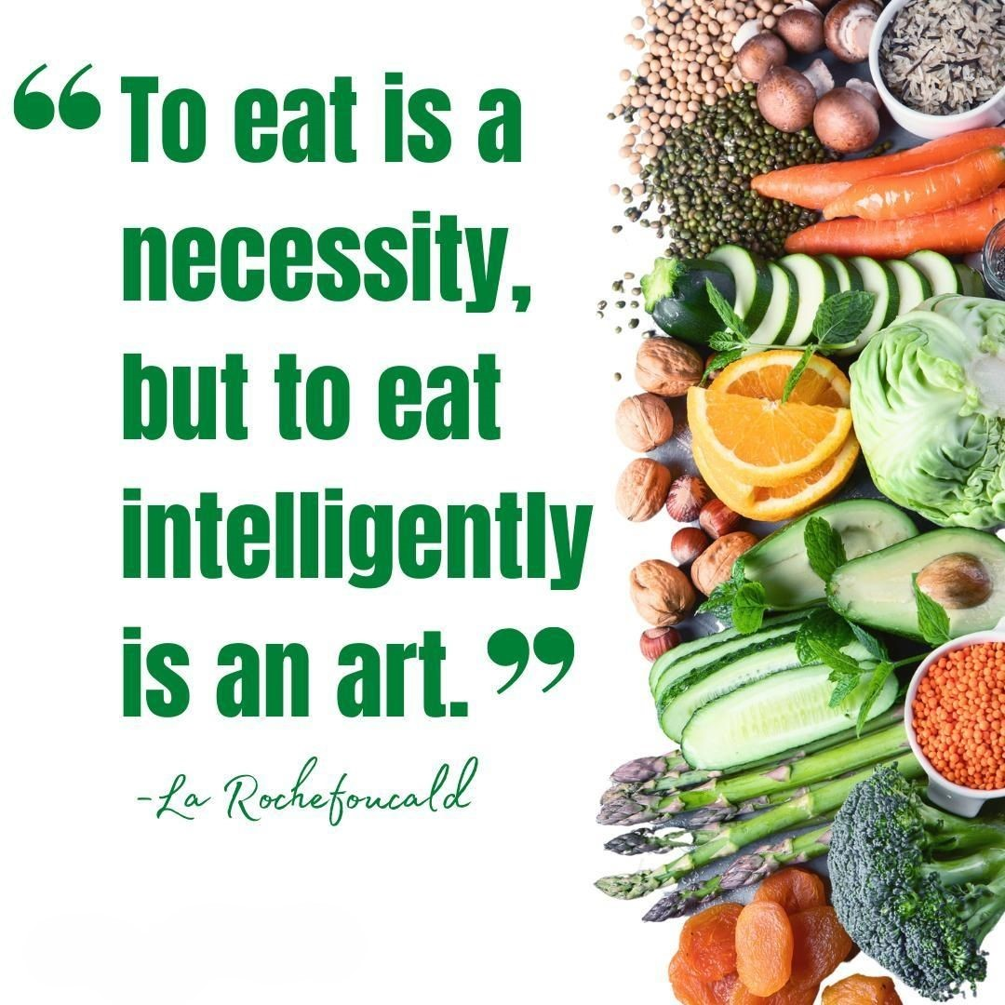



Slide 3
Why it is an art ?
This art is all about the nutritionally balanced diet and nurturing our soul, body & mind.
How to master this art ?

Slide 4



We have mastered this art for you.
By: Meenu, Anitta, Zaskia, Chatuli, Zohreh

Slide 5
PRODUCT VISION
A Smart Assistant for Meal Planning & Grocery Shopping
CookNCart, your ultimate culinary companion, designed to revolutionize the way you cook and shop for ingredients.
Imagine having a personal dietician & chef at your fingertips
- Customized meal plans for the week ahead and auto generated shopping lists with all the ingredients you need.
Effortless meal planning with an endless array of mouthwatering recipes tailored to your dietary preferences and cuisine type.

Slide 6

Personas
Parents :
John and Lisa Johnson,
Ages: Both in their early 40s
Occupations: John is a software engineer, and Lisa is a high school teacher.
Interests: Both believe “A Healthy Mind lives in Healthy Body” and ensuring their family eats healthily.
Children:
Emily (12 years old):
Dietary Needs: Gluten-free diet due to celiac disease.
Interests: Loves baking gluten-free treats and experimenting with new recipes she finds on CookNCart.
Michael (8 years old):
Dietary Preferences: Picky Eater. No specific dietary restrictions.
Interests: Enjoys helping his parents cook, especially when it involves making fun, kid-friendly meals.
Grandfather:
Robert Johnson (John’s father)
Age: 72
Dietary Needs: Diabetic, needs to monitor his sugar intake and eat balanced meals.
However, due to their busy lives many times they find it very time consuming and difficult to plan meals. Ultimately ending up ignoring their diet and health.

Slide 7
Enhancing Their Lives
How CookNCart Enhances Their Lives:
Customized Meal Planning: Customized meal plan for every week based on Johnsons profile that cater to Emily’s gluten-free needs and Robert’s diabetic-friendly requirements, ensuring everyone stays healthy and enjoys the meals together.
Effortless Grocery Shopping: Automatically generates shopping lists based on their meal plans, saving them time, and ensuring they never miss an ingredient.
Nutritional Guidance: Provides nutritional information for each recipe, helping Lisa and John make informed choices for their family’s diverse dietary needs.
Convenience and Accessibility: Syncs across all their devices, allowing the entire family to access recipes and shopping lists anytime, anywhere.

Slide 8
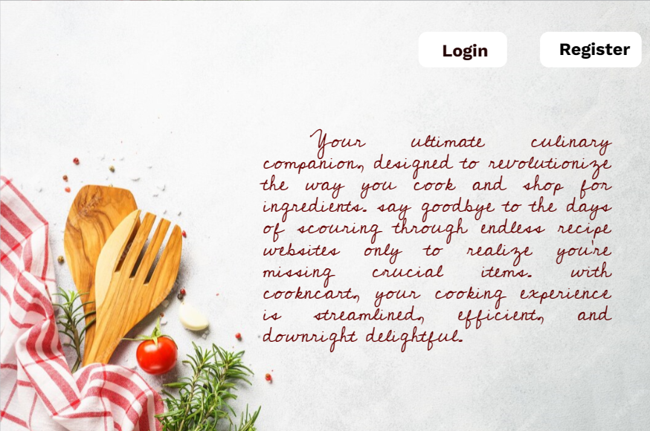
Product Overview
User-Friendly Interface
Our app has a user-friendly interface that is easy to navigate.
Saves Time
Stress free meal planning, effortless grocery shopping.
Built-in Nutritional Information
You can make informed decisions what you are putting into your body.
Cloud Syncing Capabilities
Your recipes & shopping lists are always accessible across all your devices.

Slide 9
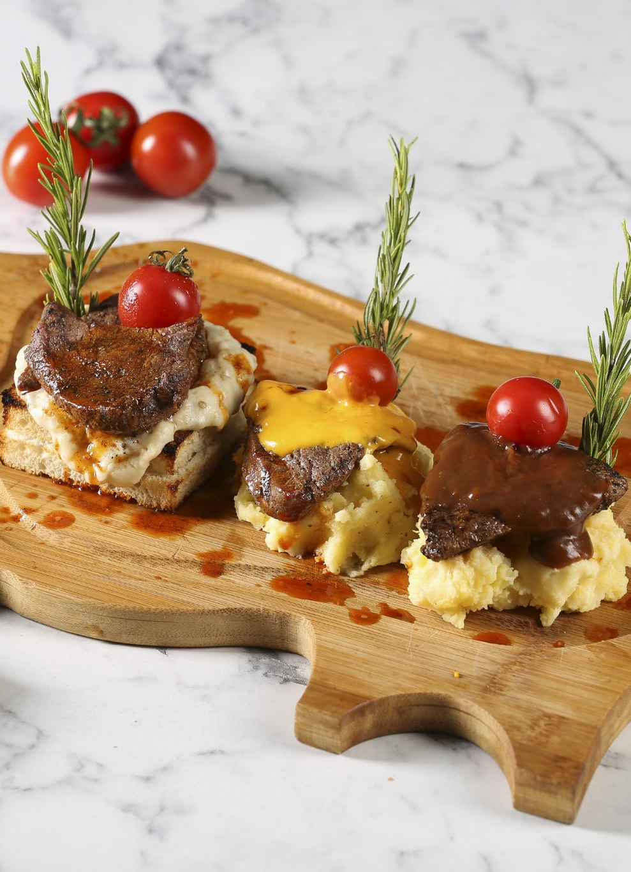
Create Account
Simple Account Creation
We have made the process of creating an account simple, quick, and easy. Users can sign up with just a few clicks using their email or social media credentials.
Customized User Preferences
Based on Dietary type, Number of Family Members, Cuisine Type, Age
Minimalistic Approach
Notes:
For new users, we have made the process of creating an account simple, quick, and easy. Users can sign up using their email or social media credentials.

Slide 10
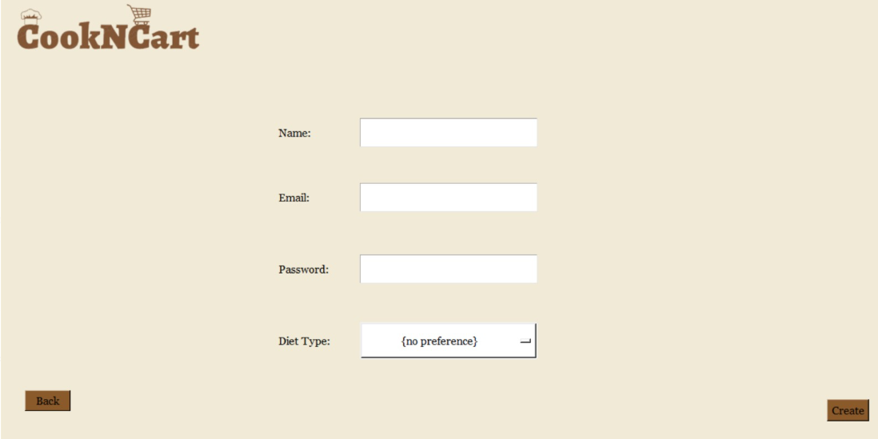

Slide 11
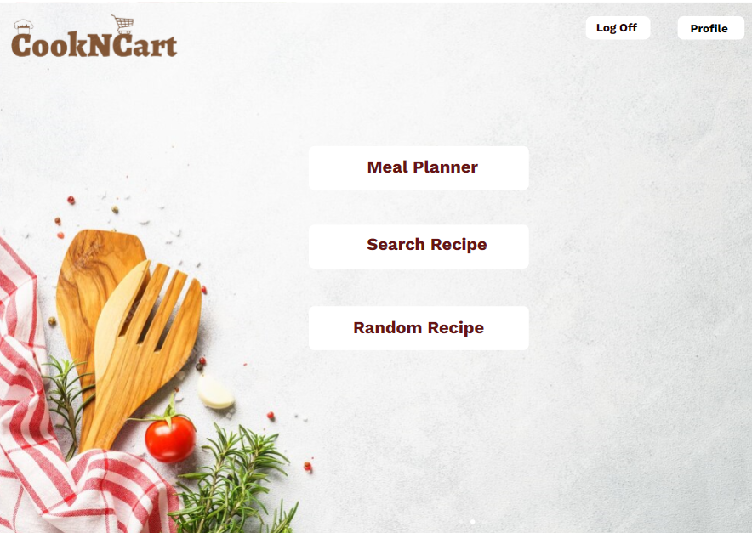
Welcome Screen
The welcome screen is the central hub for all the features of the app and is the first screen that users see after logging in.
Notes:
Once users have logged in, they will be directed to the welcome screen. The welcome screen is the hub for all the features of the app.

Slide 12
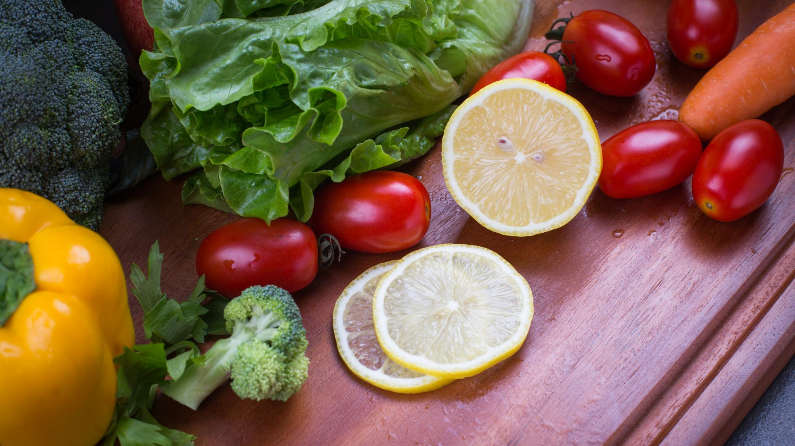
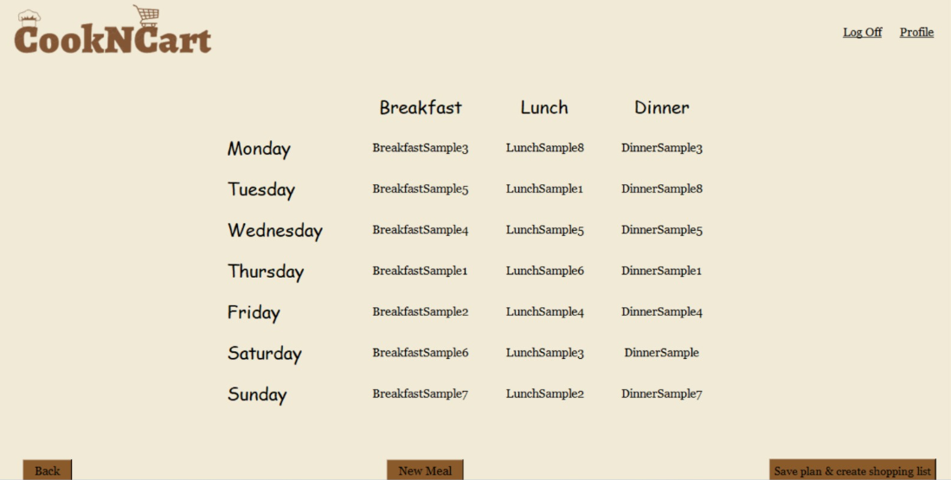
A Family's Journey to Better Health
Meal Planner (Simplifies life for a family with different dietary needs)
Notes:
Meet the Johnson family, who all have different dietary needs but want to eat healthier. The family consists of two kids, their parents, and grandparents. One child requires a gluten-free diet, and the grandfather needs a diabetic diet. They want to make meal planning easier and more efficient. Our app provides personalized recommendations and a grocery list based on dietary restrictions. With easy sharing and collaboration features, the entire family can work together to plan meals that everyone can enjoy and that are healthy for them.

Slide 13

Generate Shopping List and Email
Generate Shopping List
Users can generate a shopping list with just one click. The app will automatically generate a list of ingredients needed for each recipe and compile it into a single list.
Email Shopping List
Users can email the shopping list to themselves or share it with others, making it convenient and easy to access the list anytime, anywhere.
Notes:
Once users have selected their recipes, they can generate a shopping list with just one click. The app will automatically generate a list of ingredients needed for each recipe and compile it into a single list. Users can also email the shopping list to themselves or share it with others.

Slide 14
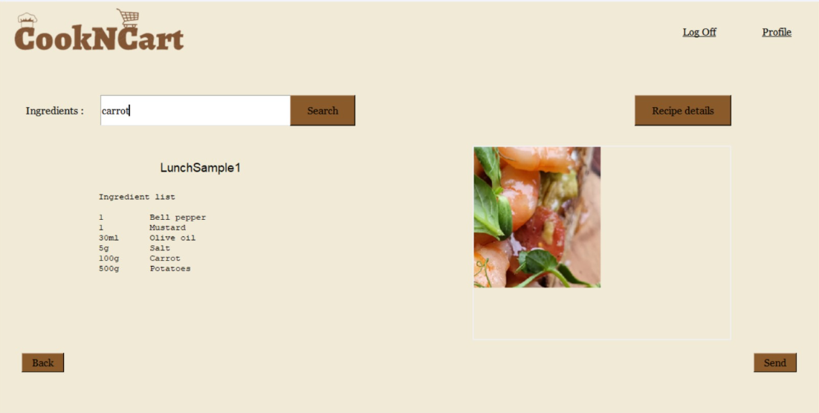
Search Recipe (Users can search recipe based on ingredients, or dietary preference)
Notes:
Once users have logged in, they will be directed to the welcome screen. The welcome screen is the hub for all the features of the app.

Slide 15
Random Recipe ( User can get recipe based on user login time)
INSERT SCREEN SHOT
Notes:
Once users have logged in, they will be directed to the welcome screen. The welcome screen is the hub for all the features of the app.

Slide 16
Display Recipe ( User can display recipe and change the portion size)
INSERT SCREEN SHOT
Notes:
Once users have logged in, they will be directed to the welcome screen. The welcome screen is the hub for all the features of the app.

Slide 17
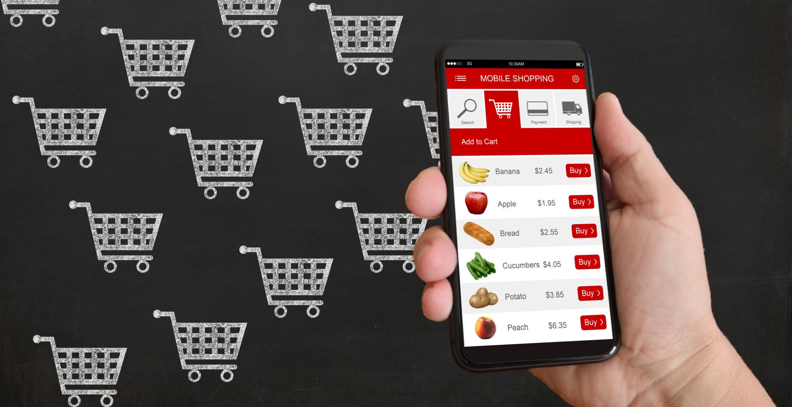
Generate Shopping List and Email
After selecting their recipes, users can generate a shopping list with just one click. The app will automatically compile a list of ingredients needed for each recipe and compile it into a single list that can be emailed or printed for convenience.
Notes:
After users have selected their recipes, they can generate a shopping list with just one click. The app will automatically generate a list of ingredients needed for each recipe and compile it into a single list.

Slide 18

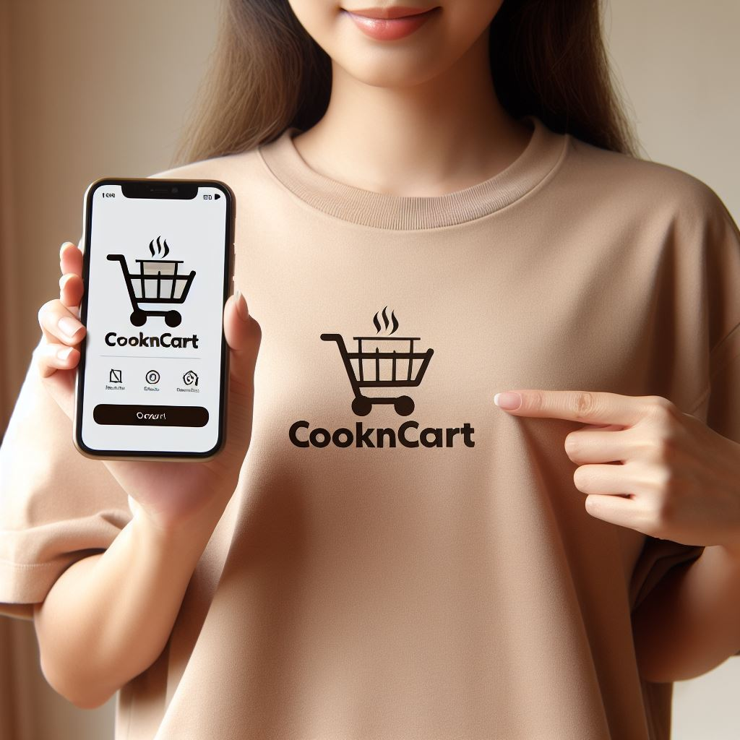

Conclusion
SDG’s Goal
More than an app, committed to promote physical and mental well-being.
By CookNCart Team belief : “Healthy Mind lives in Healthy Body”
Notes:
Our app is designed to make meal planning and grocery shopping easy and convenient. With its user-friendly interface, personalized meal planning, and easy-to-use search feature, our app is the perfect tool for anyone looking to save time and money in the kitchen.

Slide 19
Questions ?

Slide 20
Thank You !

